Slide 1
Developing Knowledge in Arduino
Phenomena

Slide 2
Review: Function
A function is a group of statements that together perform a task. Every C program has at least one function, which is main(), and all the most trivial programs can define additional functions.
You can divide up your code into separate functions. How you divide up your code among different functions is up to you, but logically the division is such that each function performs a specific task.
A function declaration tells the compiler about a function's name, return type, and parameters. A function definition provides the actual body of the function.

Slide 3
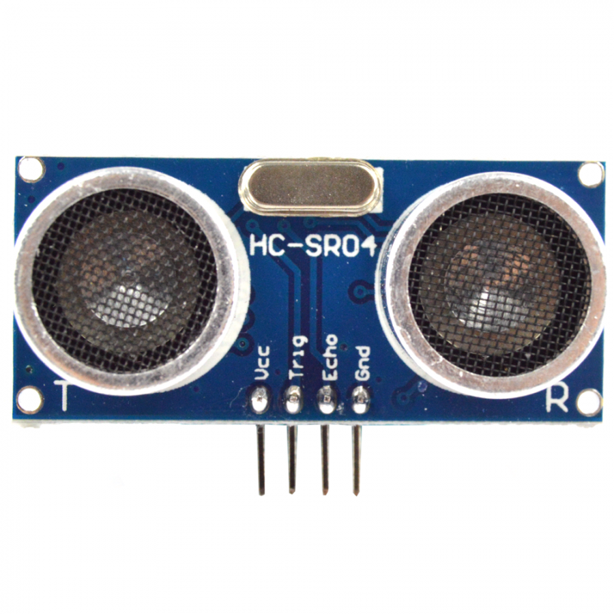
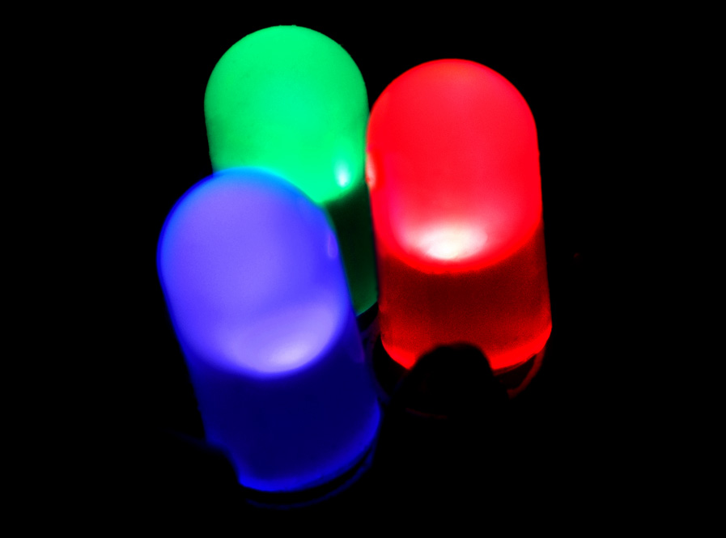
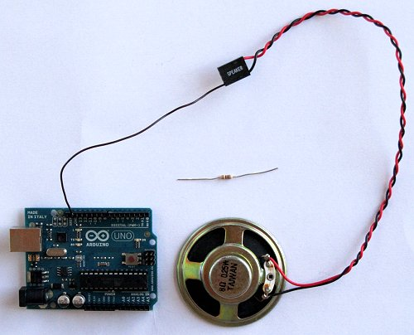

Halloween Project
Ultrasonic
LED
Speaker
Motor

Slide 4
Today
How to Drive A Servo

Slide 5
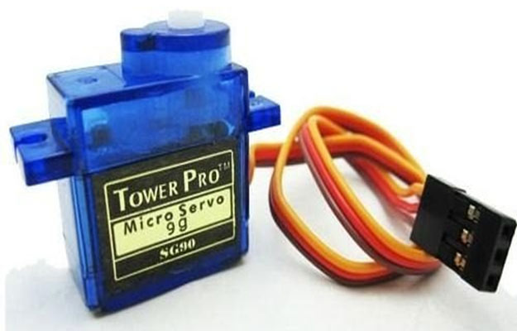
What is a Servo?
It is a type of motor.
A servomotor is a rotary actuator or linear actuator that allows for precise control of angular or linear position, velocity and acceleration.

Slide 6
Loops
A control flow statement for specifying iteration, which allows code to be executed repeatedly.
For Loop

Slide 7
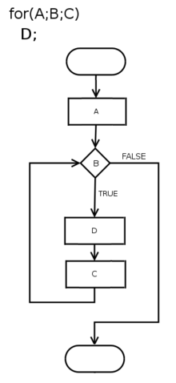
For Loop
for (initialization; condition; afterthought)
{
// code for the for-loop's body goes here.
}

Slide 8
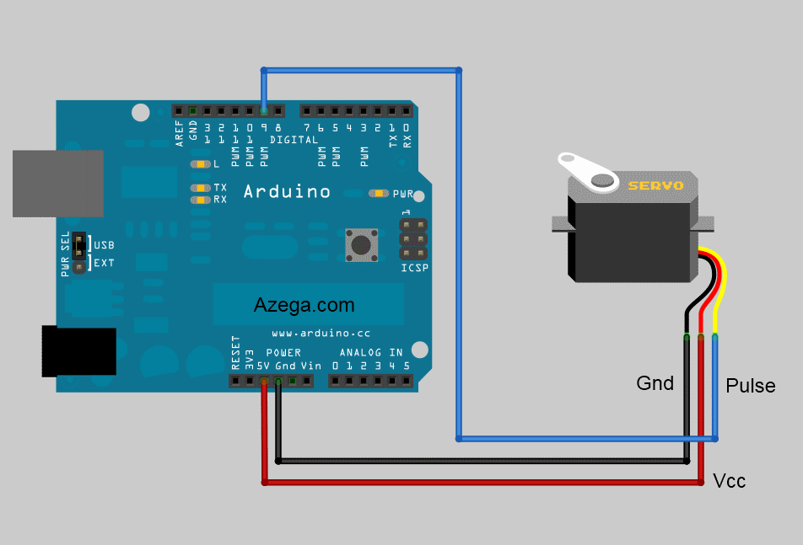
How to Connect a Servo to Arduino

Slide 9
Example Code
www.github.com/GNSPhenomena
Meeting_4
examples

Slide 10
Try modify the example code
Have fun!

